Slide 1
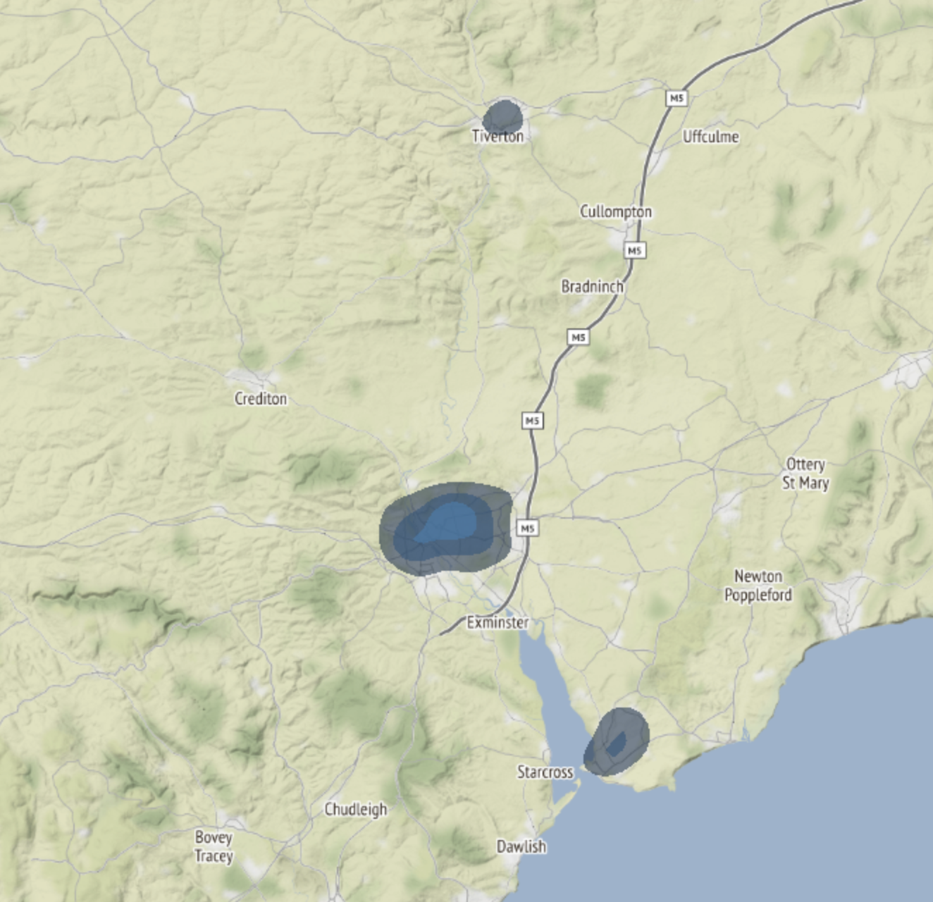
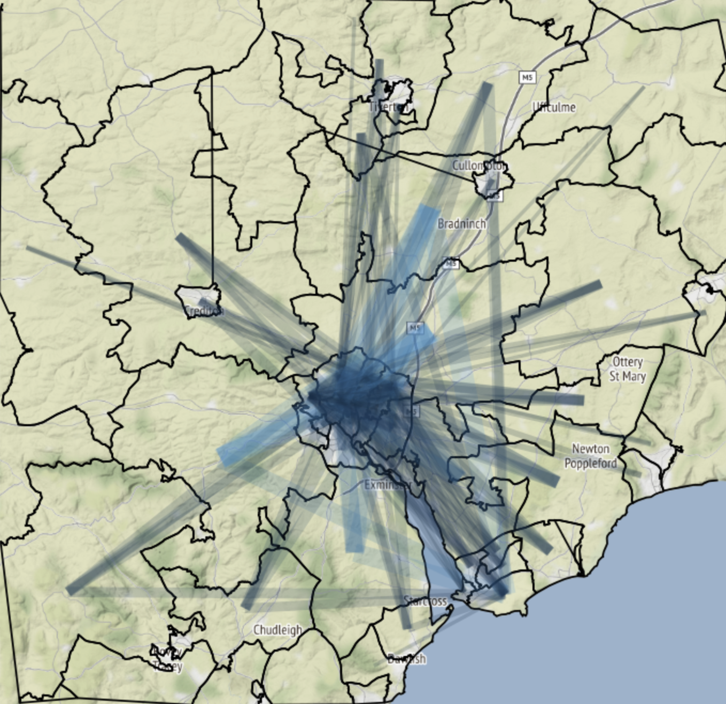
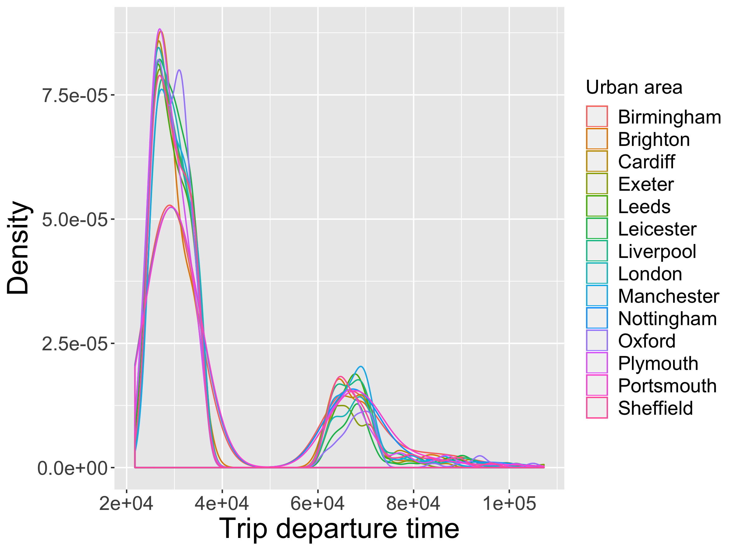
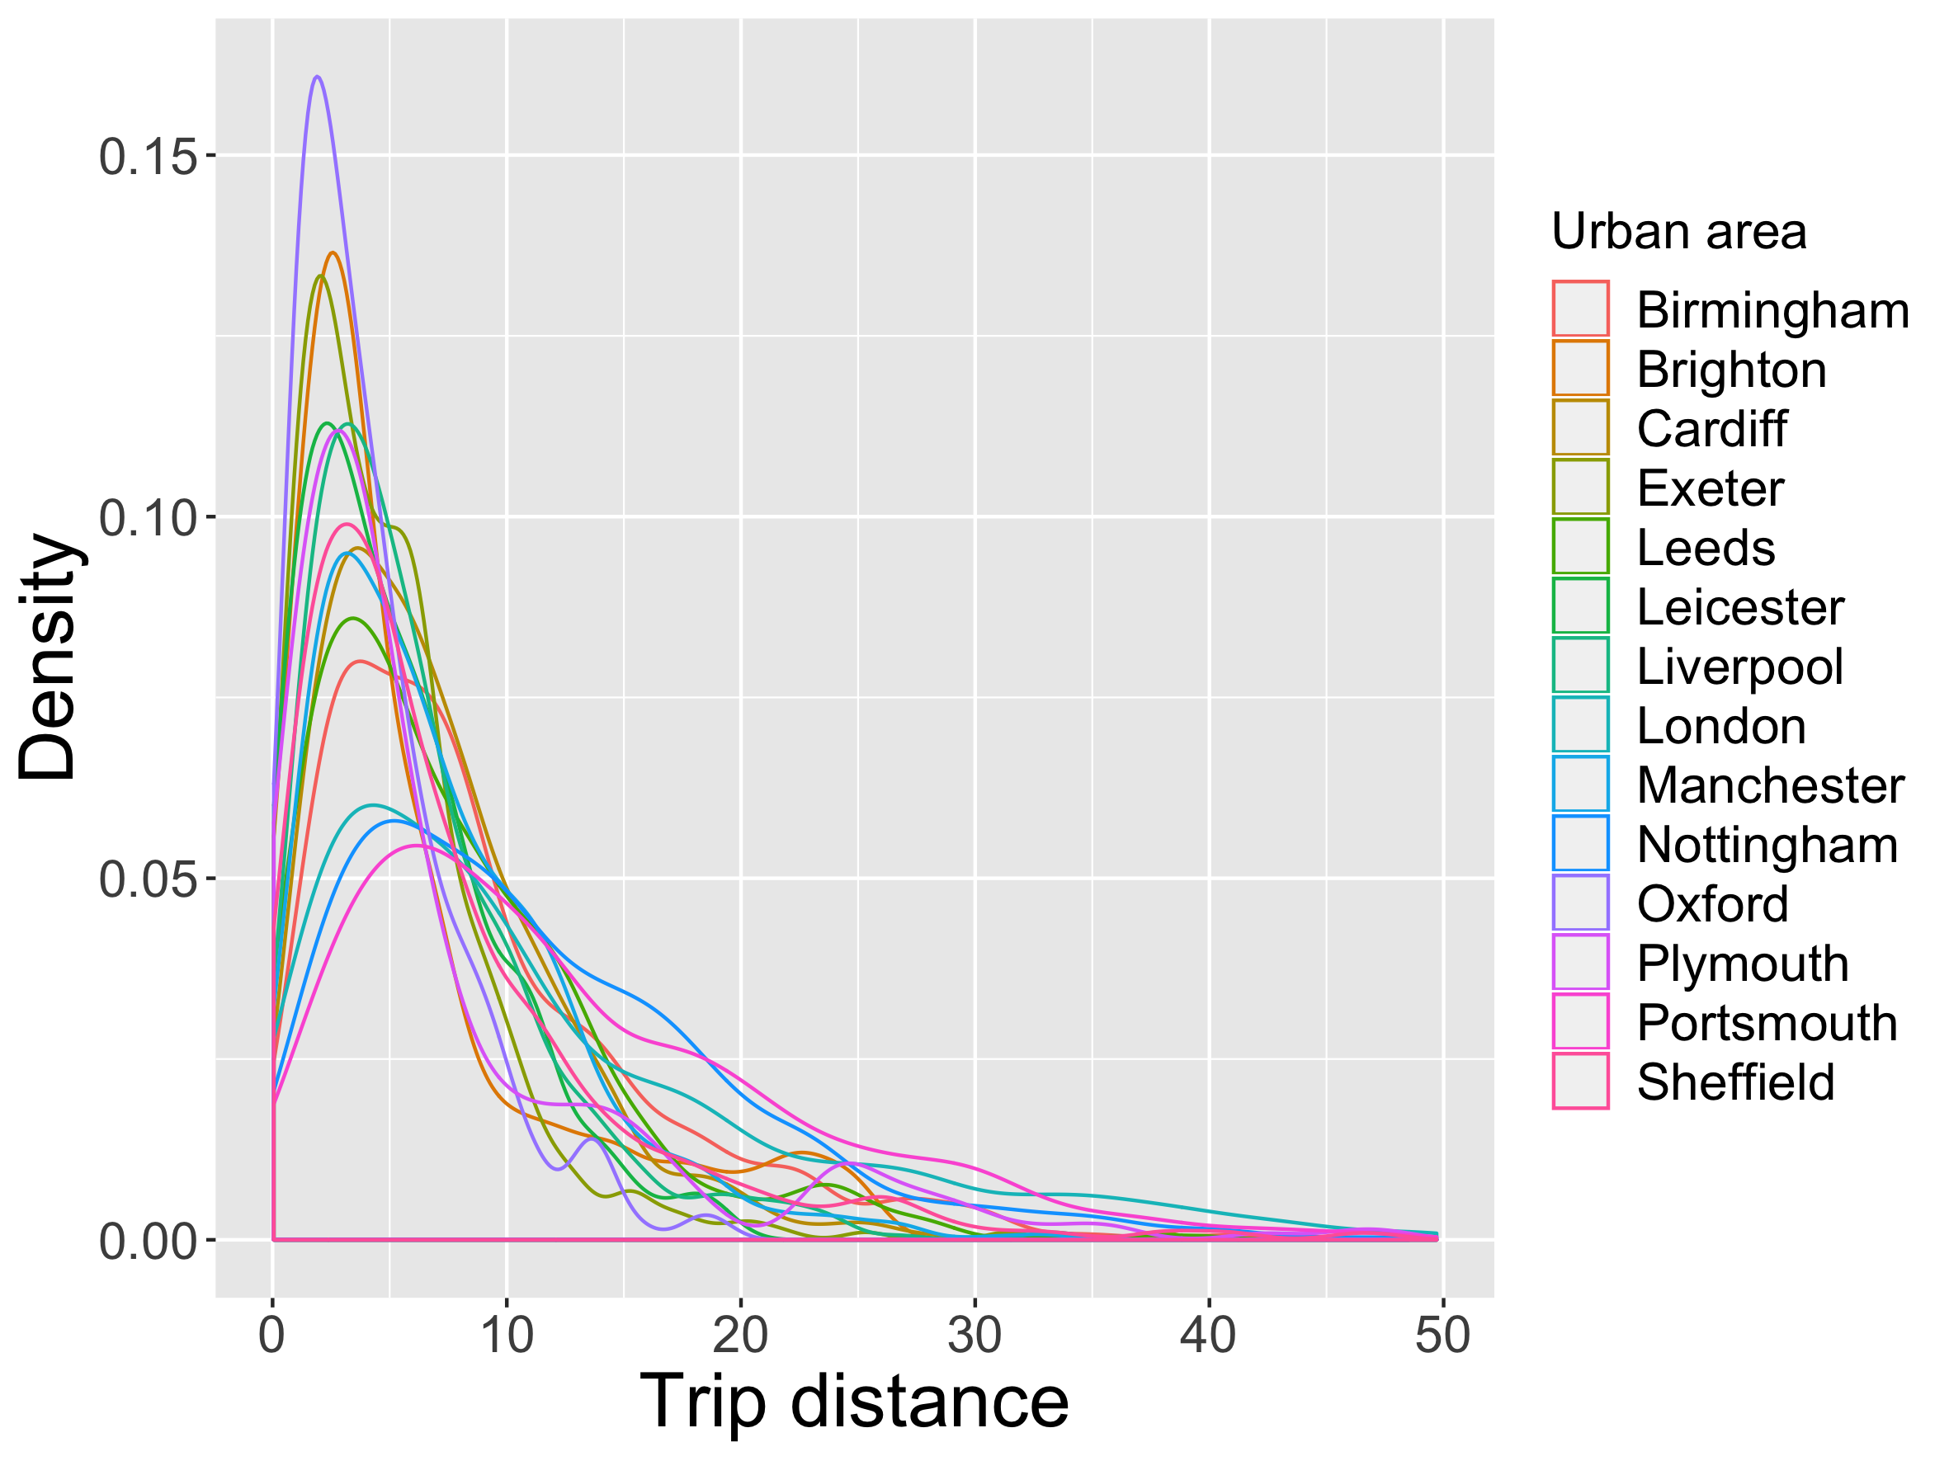
Building open transport models around MATSim
Integration of MATSim transport microsimulation framework (agent level, activity-based, multimodal) into DAFNI
Open four-step transport model constructed with the workflow system
SPENSER model (NISMOD) for synthetic population, QUANT model (CASA, UCL) for commuting flows, spatialdata library for data pre- and postprocessing
Run on any UK functional urban area or arbitrary perimeter
Sensitivity analysis and calibration using the OpenMOLE model validation software
Application to crowding indicators in public transport, test of policies to ensure social distancing

